Slide 1

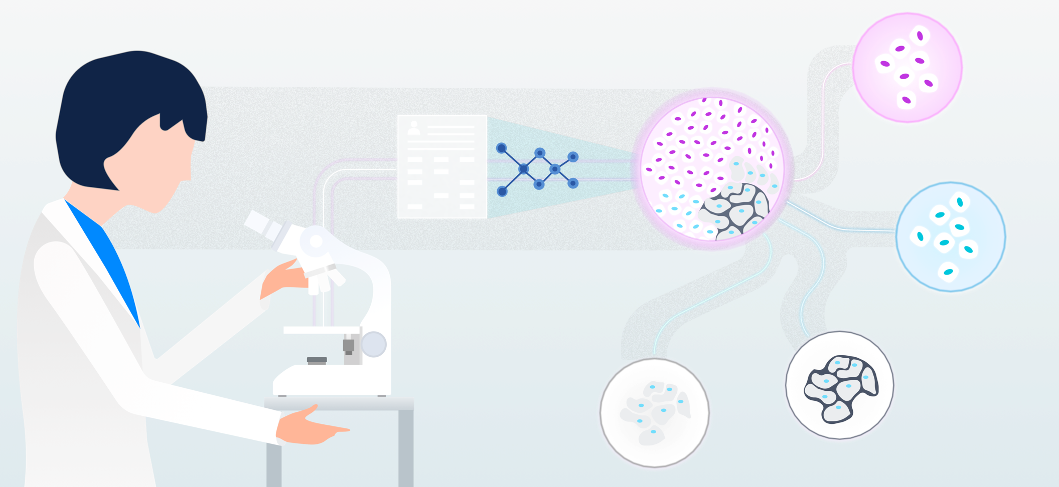
Histopathologic Cancer Detection using Deep Learning

Slide 2
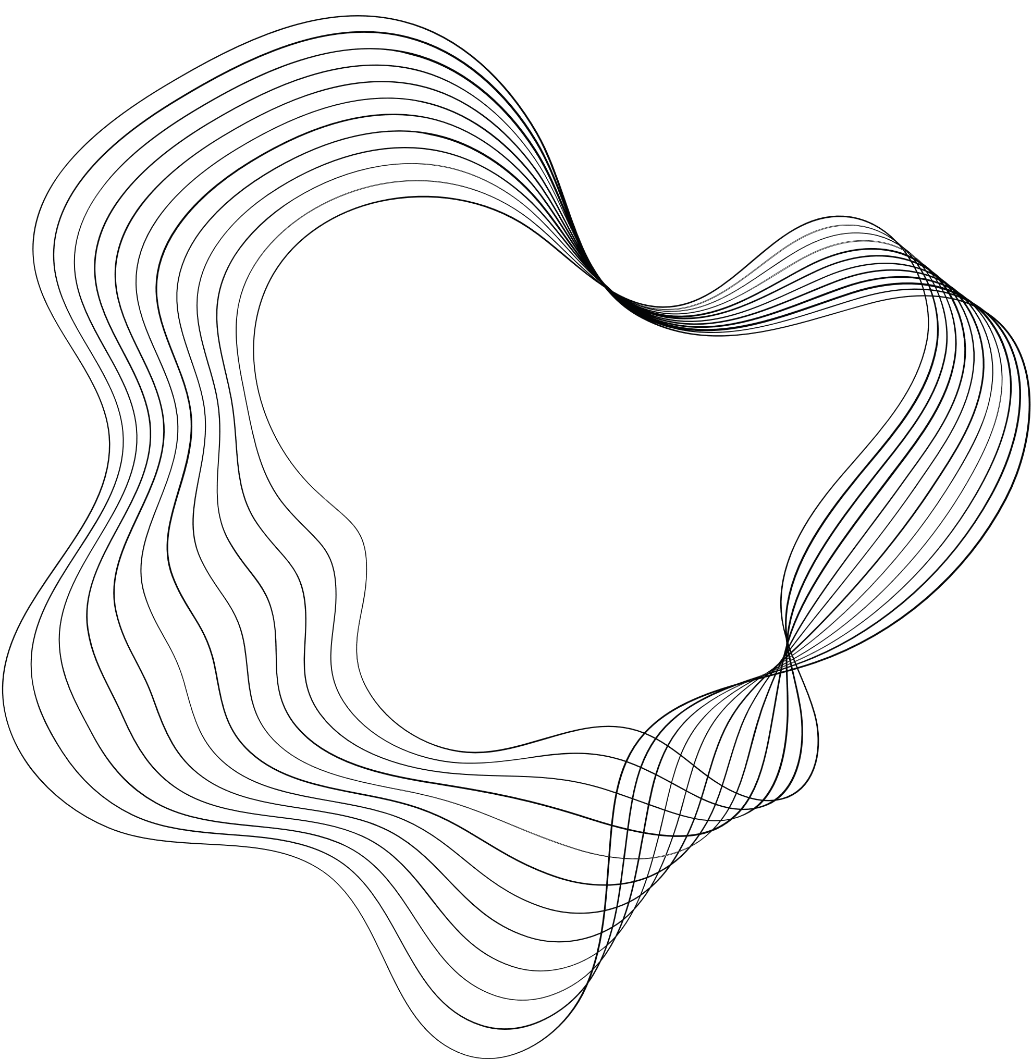

TEAM-4
Mallikarjun Aitha
Saileela Uruvakili
Venkata Sai Rakesh
Team Leader
Data Scientist
App Developer

Slide 3
BUSINESS UNDERSTANDING
Metastatic cancer is a serious health issue that requires early detection and treatment. By identifying tumor tissue in small image patches, we can help doctors and medical professionals detect cancer earlier and improve patient outcomes.
The utilization of Deep Convolutional Neural Networks for precise cancer identification in minute image patches holds significant promise for personalized medicine.

Slide 4

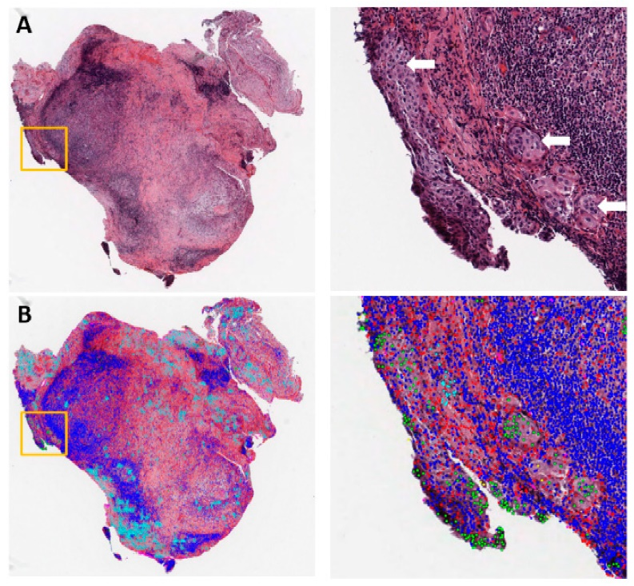
PROBLEM STATEMENT
How can deep learning algorithms be leveraged to improve the accuracy and efficiency of cancer detection in histopathologic images, ultimately aiding pathologists in timely and accurate diagnosis?
SOLUTION
Train deep learning models on histopathologic images to identify cancerous cells accurately.
Use advanced neural network architectures like CNNs to focus on relevant features.
Integrate computer-aided diagnosis systems to aid pathologists in making timely diagnoses.

Slide 5
DATA UNDERSTANDING
Dataset Overview:
The dataset contains a large number of small pathology images to classify. The files are named with an image ID, and the dataset provides the ground truth for the images. The dataset contains over 220k color images of size 96x96 pixels.
Labeling Criteria:
A positive label indicates that the center 32x32px region of a patch contains at least one pixel of tumor tissue, and the tumor tissue in the outer region of the patch does not influence the label.

Slide 6
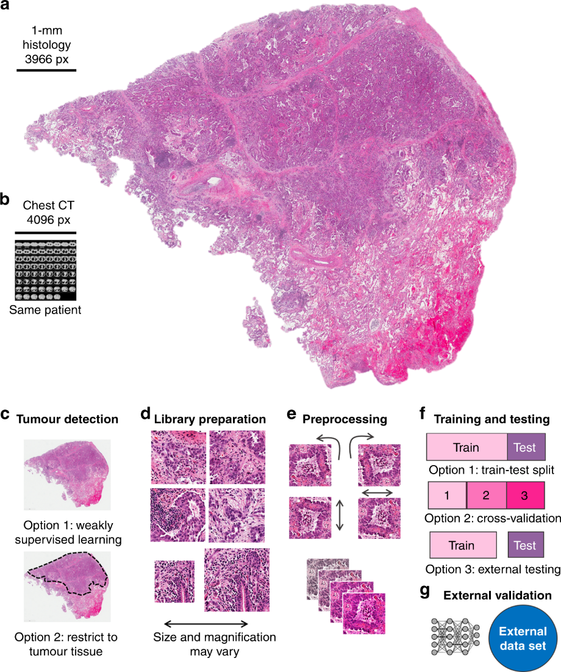
DATA PREPARATION AND VISUALIZATION
Resizing: Images are resized to a consistent size (e.g., 96x96 pixels) for uniformity.
Normalization: Pixel values are scaled to a range between 0 and 1 for better convergence.
Data Augmentation: Techniques like rotation, flipping, and shifting create additional training samples.
ImageDataGenerator: Frameworks like Keras offer the class for easy data augmentation and preparation.

Slide 7

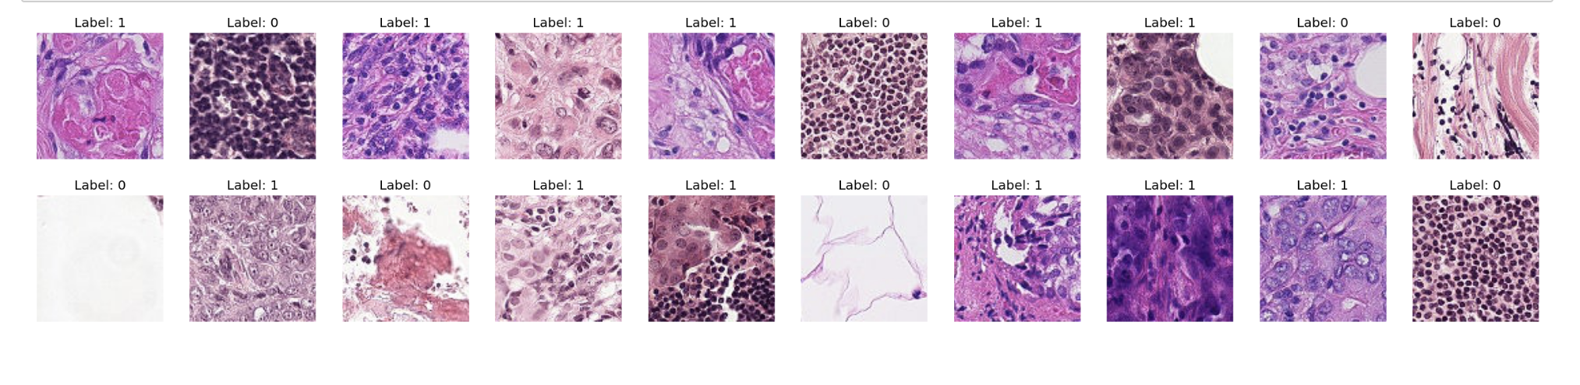
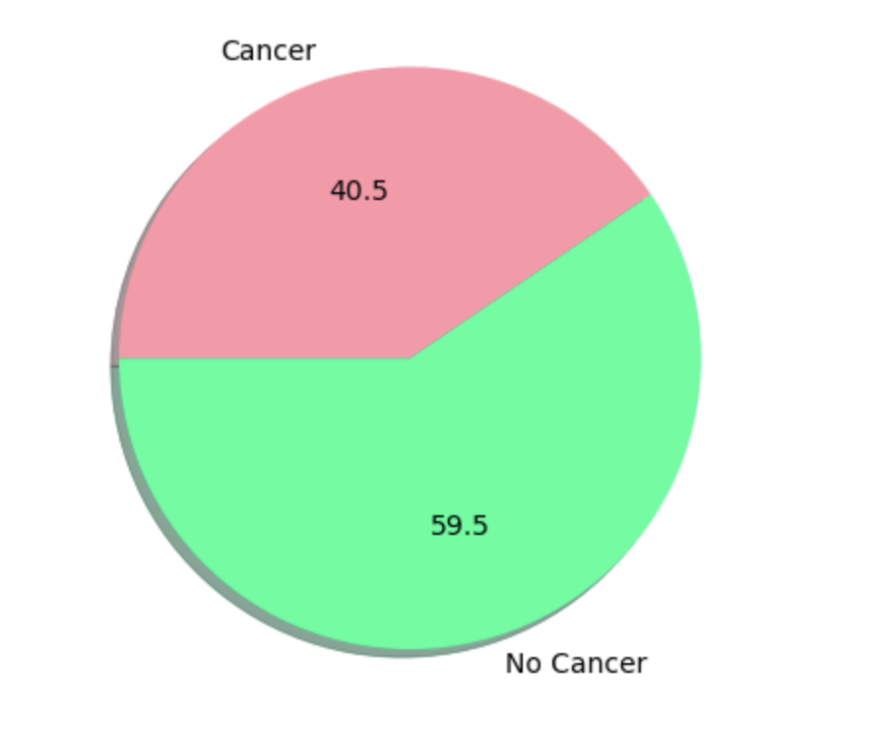
Screenshot 2024-03-02 at 10.50.03 PM

Slide 8
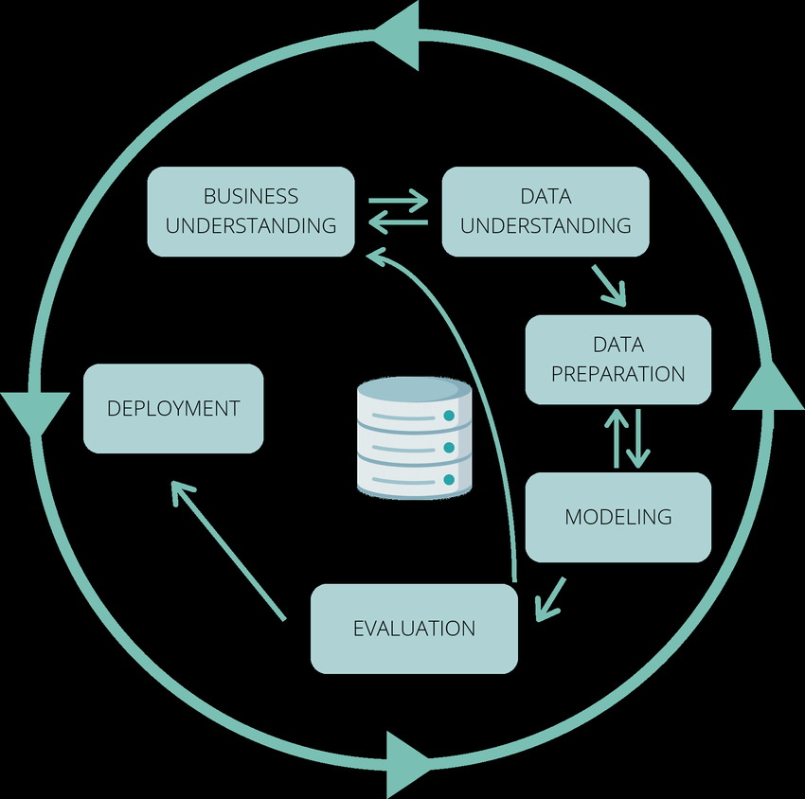
CRISP-DM
METHODOLOGY

Slide 9







TECHNOLOGIES

Slide 10
RESOURCES
https://www.kaggle.com/competitions/histopathologic-cancer-detection
https://www.mdpi.com/2072-6694/15/14/3608?type=check_update&version=2
https://www.youtube.com/watch?v=9Mz84cwVmS0 - Detecting cancer in real-time with machine learning
https://www.youtube.com/watch?v=7MceDfpnP8k - Cancer Detection Using Deep Learning

Slide 11

THANK YOU

